Slide 1
Oklahoma Department of Commerce Overview

Slide 2
Oklahoma State Regents
10 November 2015
Vince Howie
Aerospace & Defense Director
Oklahoma Dept of Commerce
Notes:
Hi, my name is Vince Howie and I am the Aerospace & Director for the Oklahoma Department of Commerce. A little about myself… I’m a retired senior civilian for the United Stated Air Force (USAF), a former member of the Senior Executive Service (SES) which made me equivalent to a General Officer. I worked 29 years the Air Force retiring two years ago. During my career, I have worked in the Pentagon, lived in DC twice, I ran the B-2 Bomber Program, was the Chief of Logistics for Air Mobility Command (AMC) which ran all the MRO activities for AMC, and ran depot maintenance at Tinker Air Force Base which located in Oklahoma. At Tinker, I had about 9000 people working for me doing the MRO activities of the Air Force. After retiring from the Air Force during the last sequester program, I came to work for the Oklahoma Department of Commerce about one and half years ago. My job now is to represent the Oklahoma Aerospace and Defense Industry and to grow current businesses in Oklahoma while attaching new companies to our state.

Slide 3
Overview
US Aerospace Outlook
Aerospace in Oklahoma
Why MRO Activity in Oklahoma
Oklahoma is National Leader in MRO
Why Companies Move to Oklahoma
Oklahoma Department of Commerce
Incentive Programs
Contact Information
Notes:
These are the subjects I will cover today…

Slide 4
US Aerospace
Commercial
General
Aviation
Defense
Unmanned Aerospace Systems
Space

Slide 5
Aircraft
Engines
Commodities
Software
MRO
Maintenance
Repair &
Overhaul
Machining
Modification
Replacement
Engineering
Recondition
Teardown
Test and Evaluation
Parts Manufact
-uring
Software
Time Change
Additive
Manufacturing
Continuous Process
Improvement
Out if the Box Innovation
Notes:
MRO stands for Maintenance, Repair and Overhaul which is comprised of many types of activities. These are depicted around the circle. They are modification, replacement, recondition, teardown, test & evaluation, parts manufacture, software, engineering, machining, and time change just to mention a few. Software is the fastest growing segment of the MRO world today. The future challenge getting enough of the right people in electrical and software engineering.

Slide 6
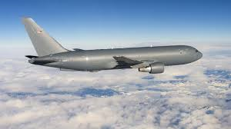
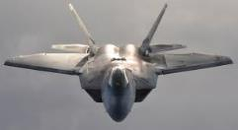
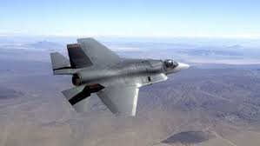
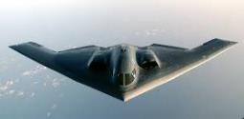
Software Evaluation
15M
Predictive
Lines of Code
9M
KC-46
2M
F-35
1.5M
F-22
Predictive Analytics
300K
B-2
Increasing lines of code drives
demand for electrical and
software engineers!
F-16
Notes:
This slide shows the evaluation of software starting with the F-16

Slide 7
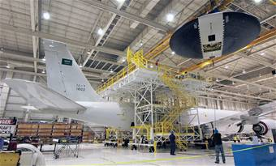
Military MRO by the Numbers
Over the next five years US military aircraft fleet requires $432 billion in MRO spending
Equals $86.5 billion per year
US military MRO demand represents more than 60% of total MRO demand worldwide
Source: Penton Aviation Week Network
Notes:
Over the next five years US military aircraft fleet requires $432 billion in MRO spending which equals $86.5 billion per year. US military MRO demand represents more than 60% of total MRO demand worldwide.

Slide 8
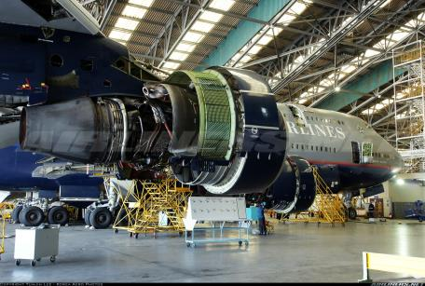
Commercial MRO By the Numbers
Total U.S. MRO revenue for 2015 for commercial services is forecasted at approximately $23 billion
There are approximately 4,000 FAA certified maintenance facilities with over 200,000 employees
Global MRO market expected to grow from $57 billion (2014) to $86 billion (2024)
Revenues for US engine repair expected
to grow 5% per year between 2015-2019
Source: Asset Reliance International, LLC August 12, 2015
Notes:
Total US MRO revenue for 2015 is forecasted to be $23 billion. There are approximately 4000 FAA certified repair stations in the US employing over 200,000 people. The Global MRO market is expected to grow from $57 billion to $86 billion in the next ten years. Revenues for US engine overhauls will increase 5% per year over the next 5 years.

Slide 9
Centrally Located in US
Boeing
Boeing Headquarters
GE
Pratt & Whitney
Hill AFB
US Navy Fleet
Readiness Center
Washington DC
Standard Aero
Tinker AFB
Delta Tech Ops
Texas Aero Engine Service
Robbins AFB
Corpus Christie Army Depot
Notes:
As you can see the MRO facilities are located allover the US. Oklahoma is centrally located in the United States which has helped evolve Oklahoma into the MRO leader in the nation. Boeing has most of its manufacturing located in Seattle Washington employing about 84,000 people. Their Headquarters in located in Chicago, Illinois. Also, much of the US business is located along the east and west coasts of the United States and nearly every Aerospace an Defense Company has a presence in Washington DC including the headquarters of the United States Air Force located at the Pentagon. The USAF has three locations in the US where all depot level MRO activities take place which are Hill Air Force Base (AFB) in Utah, Robbins AFB in Georgia, and Tinker AFB in Oklahoma. Tinker is the headquarters for the MRO activity and has a three star general in charge. During my time at Tinker I was his deputy for a while. Also, American Airlines located its commercial MRO facility in Tulsa Oklahoma. Oklahoma’s central location in the Untied States made it an ideal place for MRO activates.

Slide 10
MRO Activity Military Commercial
Oklahoma City Air Logistics Complex | $ 3.3 billion
US Navy Fleet Readiness Center | $ 1.9 billion
Corpus Christi Army Depot | $ 1.9 billion
General Electric | $ 1.2 billion
Warner Robins Air Logistics | $ 1.1 billion
Lockheed Martin | $ 955.5 million
Boeing Integrated Defense Systems | $932.5 million
Bell Boeing | $ 437 million
Pratt & Whitney | $ 404 million
Ogden Air Logistics Complex | $ 402 million
General Electric Engine Services | $ 1.1 billion
Delta TechOps | $ 708 million
Pratt & Whitney Network | $ 678.5 million
General Electric Strother Field | $ 509 million
American Airlines | $ 418.5 million
MTU Hannover | $ 414 million
International Aero Engines | $307.5 million
Texas Aero Engine Service LLC | $ 301.5 million
Standard Aero | $ 269 million
IBERIA EM | $ 229 million
Notes:
This chart depicts the top military and commercial MRO facilities in the US by dollars worth of work produced each year. Notice the largest military facility is in Oklahoma City.

Slide 11
Aerospace Activity in Oklahoma
OSIDA
Notes:
Oklahoma is home to five military installations, two international airports, three major commercial airports, 137 general aviation airports with 46 of them being jet capable and the only spaceport with vertical lift authorization in the US not on a coastline at Burns Flat, Oklahoma. Tinker AFB is the largest military MRO in the world employing over 26,000 people, issuing over $6 billon in contracts every year, with the largest work load and is the headquarters for the Air Force Sustainment Command which is responsible for all the MRO activities for the USAF. Also located in Oklahoma is Vance AFB and Enid AFB which are training bases for Air Force pilots and flight crews. We have two Army facilities in Oklahoma, McAlester Munitions Depo which stores and builds bombs for all services and Fort Sill which has been in Oklahoma since 1869 and is the Army’s Field Artillery Training School. Oklahoma is also home to the Mike Monroney Aeronautical Center which employs about 5500 people and trains over 20,000 air traffic controllers every year.

Slide 12
Oklahoma’s Key Industry Ecosystems
Notes:
Oklahoma has divided our economy into five “Ecosystems” looking at what generates wealth in our state: Aerospace and Defense, Energy, Agriculture, Information, and Distribution. Aerospace and Defense is number two in generating wealth due to the high wages, numbers of jobs and companies. It is only second to our Oil & Gas industry. Oklahoma has the second highest number of Oil and Gas Headquarters located in it only second to Texas. Agriculture has the most numbers of jobs but, has the lowest wages. Distribution is key because of our central location in the United States.

Slide 13
Aerospace & Defense Industry in Oklahoma
Aerospace & Defense: 7.4% of Oklahoma’s Entire Economy
Employs more than120,000 workers
Average salary: $64,000+
Industrial Output Exceeds $27 billion
Exports to 170 countries
Over 500 Aerospace-related Companies in Oklahoma
MRO, Composites, Sensors, Simulation, Education, Training, UAS
Major Aerospace Companies With an Oklahoma Presence:
Boeing, Northrop Grumman, Lockheed Martin, American Airlines, Nordam, FlightSafety International, Limco, ASCO, Honeywell, Bizjet, Rolls Royce and others
Notes:
Aerospace and Defense is big business in Oklahoma comprising 7.4% of Oklahoma’s total economy generating over $27 billion in sales every year exporting to over 170 countries around the world including South Korea. The average aerospace wage in Oklahoma is over $64,000 per year. Remember this figure I will use it again in the next slide. There are over 500 aerospace companies in Oklahoma with nearly every major manufacturer having a presence in our state.

Slide 14
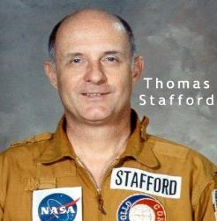
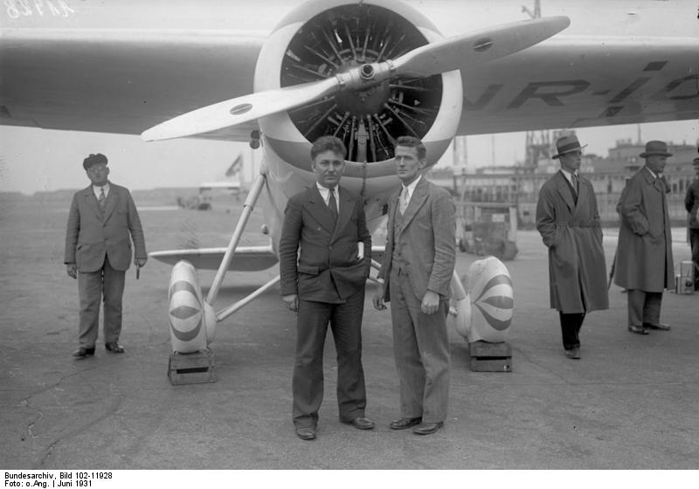
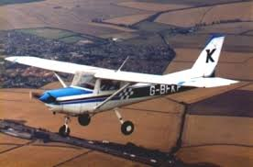
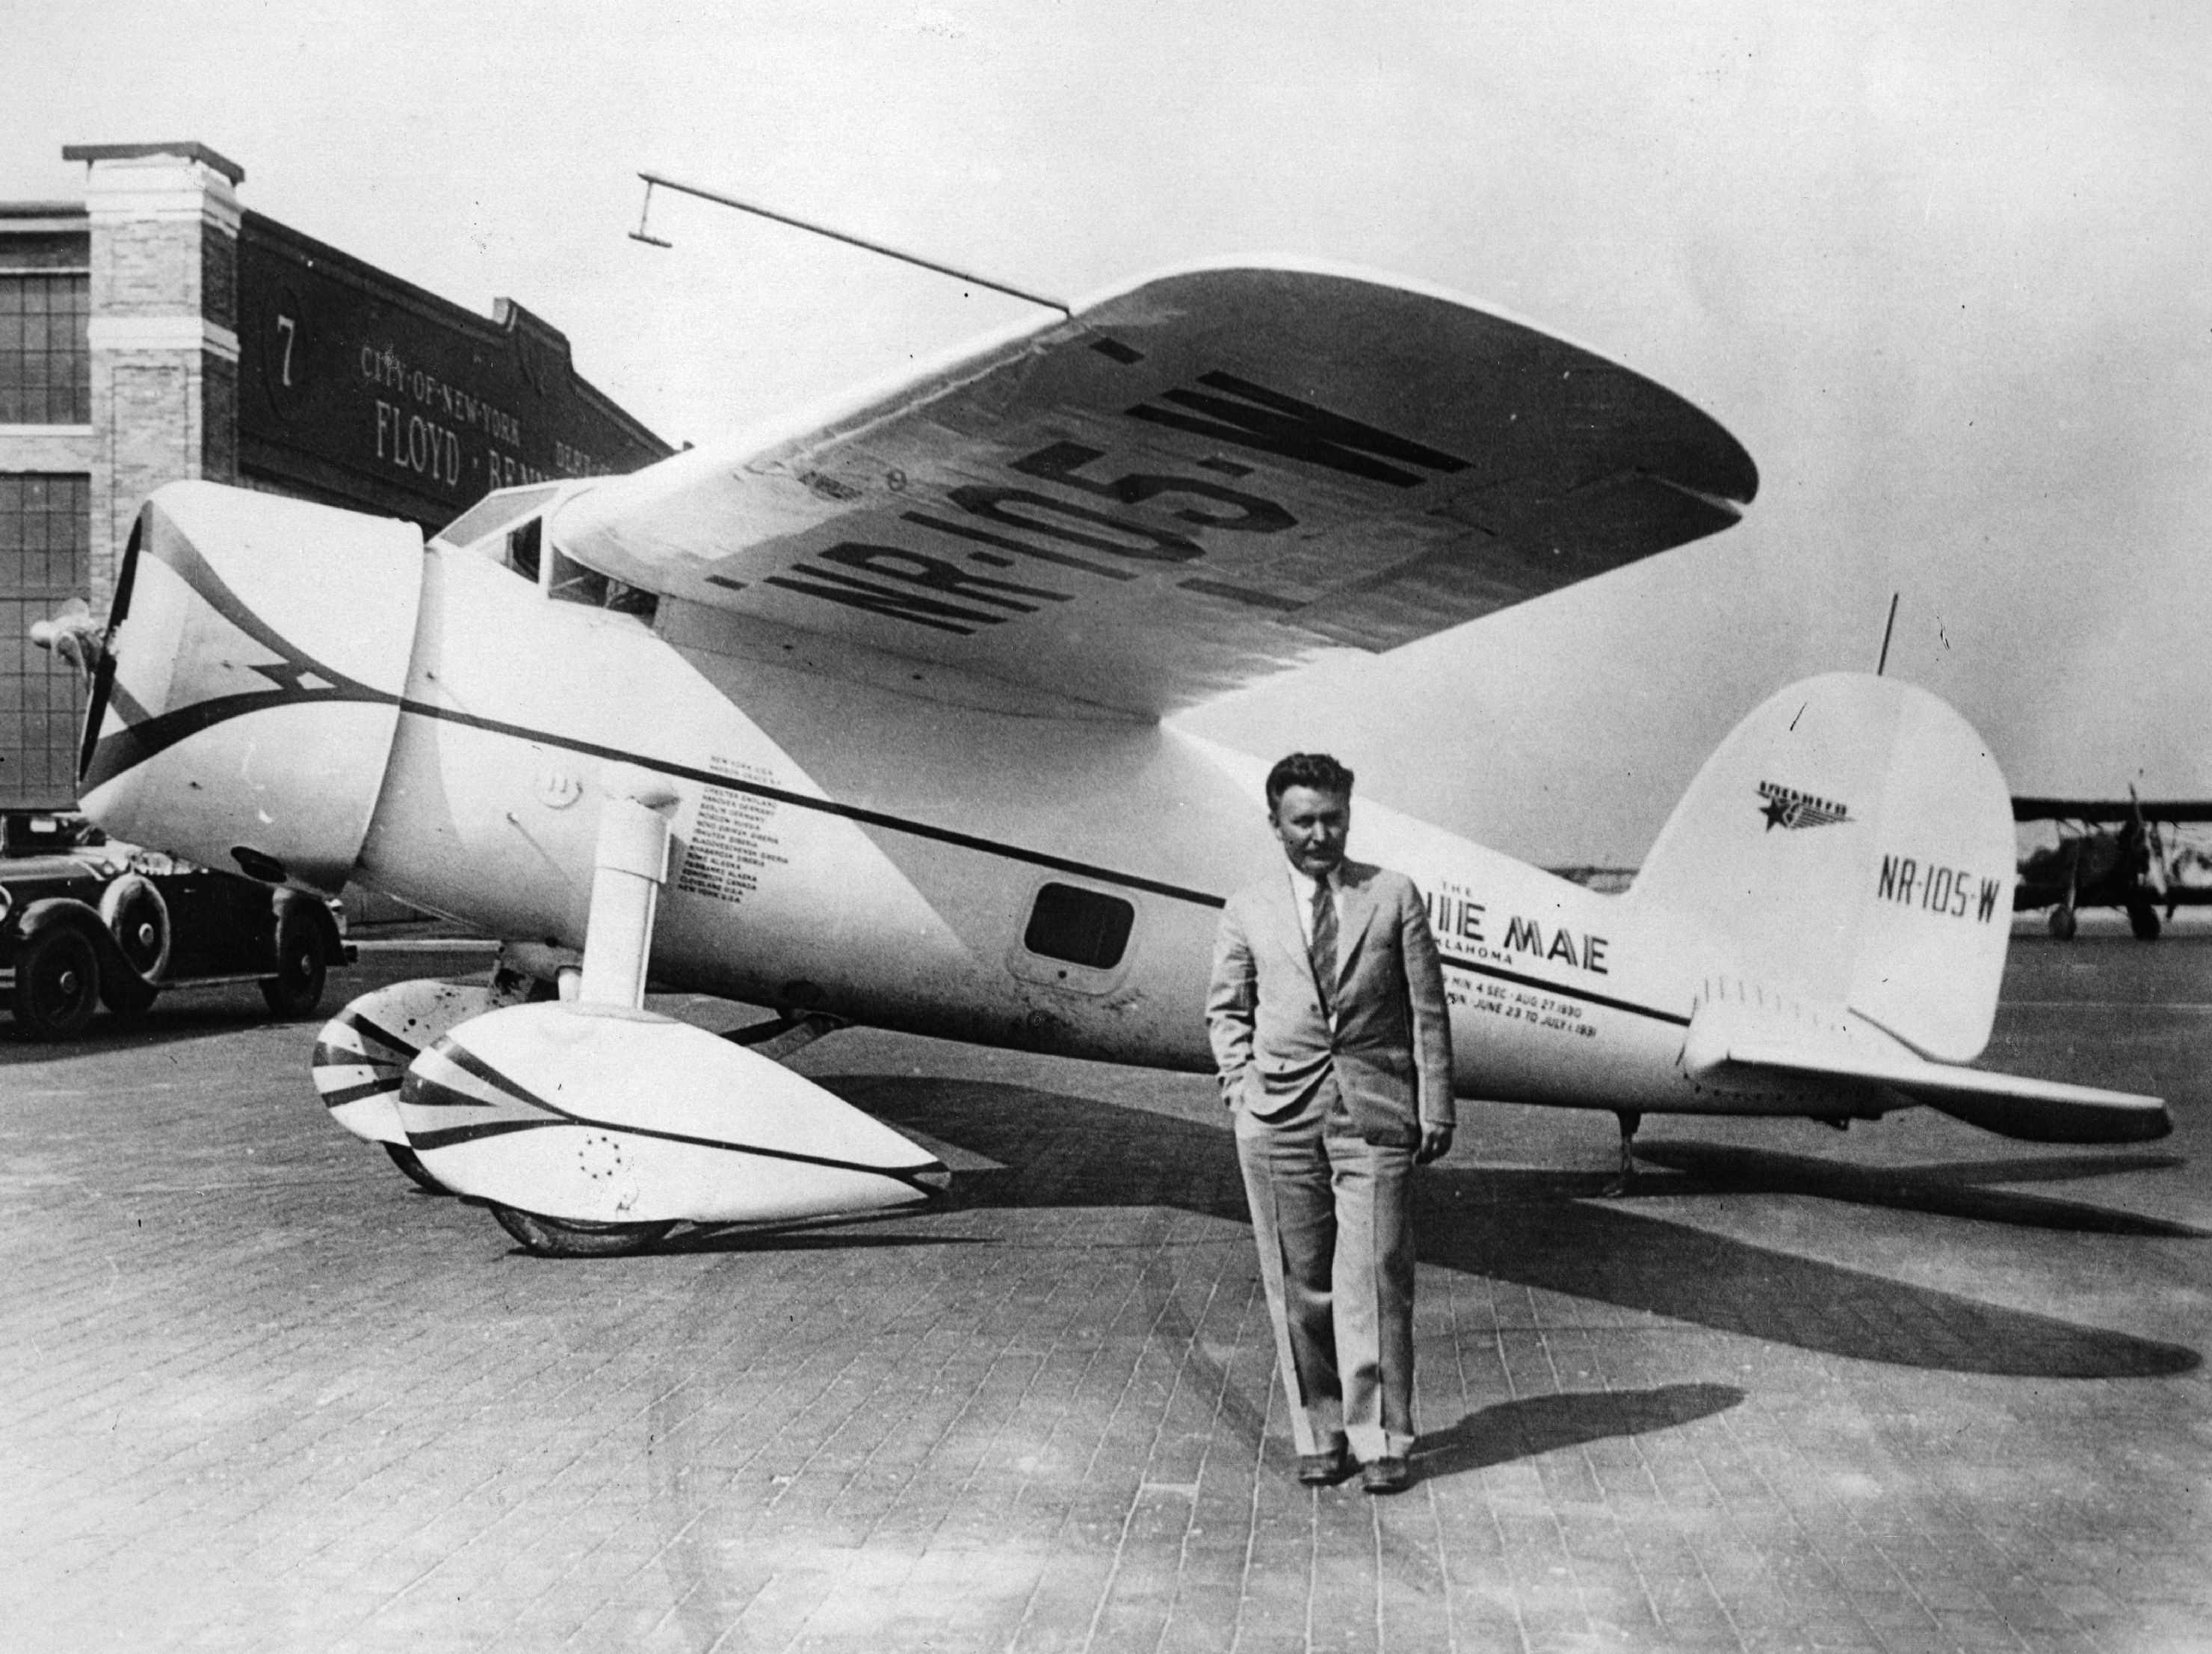
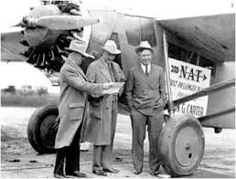
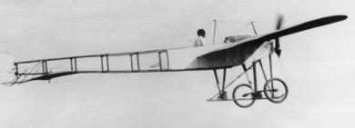
Famous Oklahoma Aviators
Will Rogers
Willey Post
Clyde Cessna
Notes:
Oklahoma has a rich history in aviation, home to many aviation pioneers such as Wiley Post who invented the pressurized flight suit, Clyde Cessna, and eight astronauts, two of which were very involved in the early space program, Gordon Cooper and Tom Stafford that actually went to the moon.

Slide 15
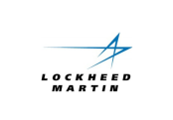
OK Fortune 500 Companies
Walmart Stores, Inc.
Exxon Mobil Corp
Chevron Corp
Phillips 66
Berkshire Hathaway
(Flightsafety Int’l)
Apple
General Motors
General Electric
Boeing
United Technologies
Lockheed Martin
Rolls-Royce
United Continental Holdings
Honeywell International
General Dynamics
Northrop Grumman
AMR
Raytheon
Southwest Airlines
L-3 Communications
Textron
Precision Castparts
Rockwell Collins
Notes:
Oklahoma has 24 Fortune 500 companies and 75% of them are in the Aerospace and Defense Industry. They are the ones in red. You can see the major players are located in Oklahoma. For example Boeing has about 2000 people in Oklahoma and just announced another 900 jobs moving to Oklahoma. They have moved people from Washington State, California, Missouri, and Kansas. Most of the people Boeing currently has in Oklahoma are engineers and program mangers. This next 900 people are scientists and lab technicians to man the new $100 million non-destructive laboratory Boeing is building in Oklahoma City. They are also moving some of their senior management people here from Missouri. With the next anticipated move this should bring their total to over 4000 jobs when all is said and done!

Slide 16
UAS in Oklahoma
Pipeline and Powerline Monitoring
Weather
Precision Agriculture
Search and Rescue
Fire and Police
Aerial Photography
Governor’s UAS Council

Slide 17
UAS Companies in Oklahoma
Company | City
Design Intelligence Inc. | Norman
Electro Enterprises, Inc. | Oklahoma City
Unmanned Cowboys | Stillwater
Zivko Aeronautics, Inc. | Guthrie
Aerostar International Inc. | Chelsea
Airbus Defense & Space | Tulsa
Ball Aerospace & Technologies Corp | Oklahoma City
B/E Aerospace | Tulsa
The Boeing Company | Tinker AFB
C2 Technologies | Oklahoma City/Altus
CAE | Altus AFB
DRS Technologies | Oklahoma City
Elbit Systems of America | Oklahoma City
FLIR Systems | Stillwater
GE Aviation | Oklahoma City
General Atomics Aeronautical Systems | Muskogee
Hughes Network Systems, LLC | Oklahoma City
Company | City
IBM | Tulsa
Ideal Aerosmith, Inc. | Tulsa
L-3 Communications | Broken Arrow/Tulsa
Lockheed Martin | Oklahoma City
Moog Inc. | Oklahoma City
Northrop Grumman | Oklahoma City
Pratt & Whitney | Oklahoma City
QinetiQ | Lawton
Raytheon | Oklahoma City
Rockwell Collins, Inc. | Midwest City
TE Connectivity | Oklahoma City
Textron Systems | Bethany
Thales Communications | Lawton
Trimble Navigation Limited | Oklahoma City
UTC Aerospace Systems
VT Group | Ft. Sill
Zodiac Aerospace (Enviro Systems) | Seminole
Notes:
The Unmanned Aero Systems is what we view as the next big boom to the aerospace industry. We have identified as least five different markets for UAS use. Currently there are 35 companies in Oklahoma that specialize in UAS systems. Here are some we have listed.

Slide 18
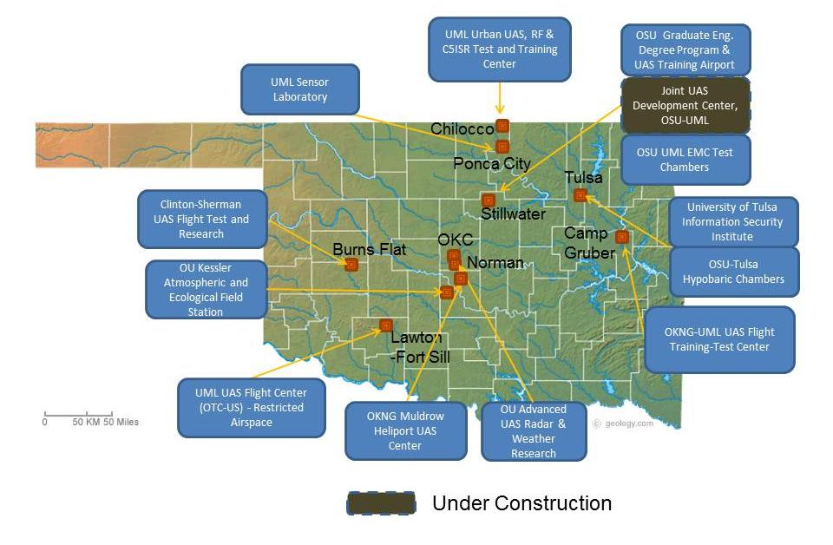
DHS Test site
Notes:
Oklahoma has plenty of places to fly including the only Department of Homeland Security (DHS) site. This means anyone desiring to fly for DHS must first prove their technology in Oklahoma. The map shows you many of the sites you can fly in Oklahoma. NASA has also selected Oklahoma as one of only three states for the NUSTAR program which will classify and rate all UAS vehicles wanting to fly in US airspace.

Slide 19
Oklahoma Space Industry Development Authority (OSIDA)
Oklahoma Air & Space Port
Only FAA-approved spaceflight corridor not in restricted airspace
Third longest runway – 13,503 ft x 300 ft
100-acre ramp space
2,000 acres of available land

Slide 20
State Economic Snapshot
Employment Growth
Jobs Added (2010-2015)
State Job Growth Rate (U.S.)
97,400
6.2% (8.7%)
Increased Wealth
Per Capital Personal Income
GDP Growth (2013 1-year) (U.S.)
Gain in OK PCPI over the Past Five Years (U.S.)
$43,138
4.2% (1.8%) “4th Best in Nation”
˄ 20.8% (13.7%)
Business Growth
More Private Businesses Created than were Closed (%)
Total Private Establishments
# of New Private Establishments
˄ 1.78%
101,248 in 2014
˄ 1325
Qualified Labor
High School Graduation Rate
OK Unemployment Rate (compared to national rate)
86.4% in 2014
4.5% current (5.3%) (Jun 2105)
OK Department of Commerce 2014 Annual Report
Notes:
This slide depicts a snapshot of the Oklahoma Economy. We have added over 97,000 jobs in the last five years exceeding the US average growth rate. Our per capita income is about $43,000 which is much lower than the $64,000 average salary paid in the aerospace and defense industry I showed you of the earlier slide. Our Gross Domestic Product (GDP) is 4th best in the nation. What I’m most proud of is our 86.4% high school graduation rate last year. The Oklahoma unemployment rate is only 4.5% , lower than the national average of 5.3%.

Slide 21
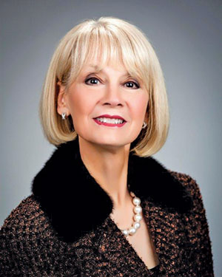
Deby Snodgrass
Secretary Oklahoma Department of Commerce and Tourism
Appointed by Gov. Mary Fallin in January 2015 while serving as Oklahoma’s Secretary of Tourism and Recreation Department Executive Director
Senior advisor to the Governor on policy, economic, and legislative issues
Notes:
I work for the Oklahoma Department of Commerce and it is headed by our cabinet secretary, Deby Snodgrass. She is a great lady and the only person between myself and our governor. Oklahoma provides easy access to our top leadership.

Slide 22
Role of Aerospace Within the OK Dept of Commerce
Business Customer Services
Aerospace
National Recruiting Team
Global Recruiting Team
Workforce Development
Focus
Notes:
We have three sections in Commerce: One that deals with growing the jobs inside our borders, one that deals with bringing new businesses in state from within the United States and one that deals with bringing business internationally or outside the US borders. Jennifer is our Director that runs our international division. Aerospace as you can see covers all three areas and is such big business to our state, that’s why they hire a specialist like me.

Slide 23
Oklahoma Business Incentives
Cash Payments for New Quality Jobs
Small Employer Quality Jobs
21st Century Quality Jobs
Quality Jobs + Investment Tax Credit
Investment/New Jobs Tax Credit
Aerospace Engineer Tax Credits
Ad Valorem Exemptions
Economic Development Pooled Finance
Former Indian Lands Tax Credit
Notes:
Incentives are a huge part of why companies like Boeing bring so many jobs to Oklahoma. We have a very business friendly state and make it easy to come do business in Oklahoma. Companies like Boeing take advantage of our Quality Jobs Program which will pay them over $43 million over the next ten years based on their number of jobs and investment. A check is mailed to each company participating in the program on a quarterly basis from the Oklahoma Tax Commission. As you can see we have many variations of the program tailored to meet most scenario's. These include from small business for companies with very few employees (2-15) to 21st Century which pays double for salaries over $94,000 per year. We also have the Engineering tax credit that provides a tax credit to both the employee and business owner. Boeing uses the Engineering Tax Credit to help recruit employees. Many communities around our state put additional incentives on top of the state incentives.

Slide 24
Oklahoma Quality Jobs Programs
Cash Payments - Up to 5% of New Payroll - Up to 10 Years
Quality Jobs Program
$2.5 million Payroll within 3 Years of Start Date
(Locating on Former Military Land Decreases to $1.5 million)
Create New Full-Time Positions
Pay New Hires Average County Wage or $32,103
Cash Payments - Up to 5% of New Payroll - Up to 7 Years
Small Employer
Quality Jobs
(90 or Fewer Employees)
Create 5 - 15 New Positions within 2 years
Pay 110% of Average County Wage
Offer Basic Health Insurance
Requires 75% Out-of-State Sales
Cash Payments - Up to 10% of New Payroll - Up to 10 Years
21st Century
Quality Jobs
Create 10 New Full-Time Hires within 3 Years
Pay New Hires $95,243
Requires 50% Out-of-State Sales
Notes:
The next two slides go into detail on how our incentive programs work.

Slide 25
Oklahoma Business Incentives
Aerospace Engineer Workforce Tax Credit
Employer Benefits:
New Engineer Grads:
50% Tax Credit for Reimbursed Tuition Costs
For First 4 Years of Employment
Hire OK Grads:
Up to 10% of Wages Paid During First 5 Years of Employment
Maximum of $12,500 per Employee Annually
Hire Non-OK Grads:
Up to 5% of Wages Paid During First 5 Years of Employment,
Maximum of $12,500 per Employee Annually
Employee Benefits:
Eligibility: Current Employed Aerospace Engineers
Eligible to Receive Individual Tax Credit
Up to $5000 Per Year for 5 Years
Governor signed 4 yr
extension to Jan 2018!
Notes:
This slide provides the details to you.

Slide 26
Aviation/Aerospace Workforce Team
12 Universities and Colleges offering Aerospace Degrees
Only PhD Program in the Nation Focused on UAS
7 Technology Centers with 59 Locations Around State
Provides Aerospace Certifications
Training and Testing
Activities for Middle and High School Students
Science Academies
Aviation Camps
Pre-engineering Programs
Notes:
Finding and training employees are always a huge concern of most employers. Oklahoma has 12 universities and colleges that offer degrees in aerospace. Also, our Career Tech system has seven main campuses with 59 locations throughout the state to train workers in the aerospace and other industries. We also encourage our high school and middle school students to discover aerospace through our Science Academies, Aviation Camps, and Pre-engineering programs.

Slide 27
What We Need From You:
Engineers
Electrical
Mechanical
Aerospace
Software! Software!! Software!!!

Slide 28
Thank You!
Oklahoma Department of Commerce
Putting people, places, and opportunities together
Here to help Oklahoma grow!
Here to help you expand your business!
Vince Howie
Aerospace & Defense Director
(405) 815-5128 office
(405) 693-4539 cell
Vince.Howie@OKcommerce.gov
Notes:
Please let me know if you have any questions or need any additional information. Here is my contact information so please feel free to contact me. Thank you!

Slide 30
Major U.S. MRO Companies
Revenue $20 Billion+
Revenue $1 - $5 Billion
Company
* Boeing
* Lockheed Martin
* Honeywell International
* Raytheon
* Northrop Grumman
* General Dynamics
* United Technologies Corp
Airbus
* Rolls-Royce
* Bombardier
* GE
* Pratt & Whitney
Company
* Rockwell Collins
* Spirit Aerosystems
* Precision Castparts
* Textron
* Finmeccanica
* Zodiac
* L-3 Communications
Company
* Teledyne Technologies
* FLIR Systems
Harris
Elbit
* Kaman
* Moog
BE Aerospace
Curtiss-Wright
* Triumph Group
Aerojet Rocketdyne
* Located in Oklahoma
Notes:
This is a list of the top MRO revenue generating companies in the US that support the MRO facilities. The first column shows companies with revenues over $20 billion, the second are companies between $5-$20 billion, and the third column are companies with revenues from $1-$5 billion. The ones with asterisks have locations in my home state of Oklahoma.

Slide 31
Major Aerospace & Defense Companies
Major Aerospace and Defense Companies in Oklahoma
Company | City | Employment | Sector
ARINC | Oklahoma City | 100-200 | UAS/MRO
Frontier Electronic Systems Corp. | Stillwater | 100-200 | UAS/Sensors/Electronics
Flight Safety | Broken Arrow | 700-800 | UAS/Flight Simulators
Labarge, Inc. | Tulsa | 200-300 | UAS/Electronics
SAIC Energy Environment | Oklahoma City | 400-600 | UAS & MRO
Acorn Growth Companies Defense | Oklahoma City | 100-200 | Government/ Dept. of Defense
Altus Air Force Base | Altus | 4,000-6,000 | Government/ Dept. of Defense
FAA Mike Monroney Aeronautical Center | Oklahoma City | 3,000-8,000 | Government/ Dept. of Defense
Fort Sill Army | Fort Sill | 16,000-20,000 | Government/ Dept. of Defense
Lockheed Martin | Oklahoma City | 100-200 | Government/ Dept. of Defense
The Boeing Company | Oklahoma City | 1700-2000 | Government/ Dept. of Defense/MRO
Northrop Grumman Systems Corp | Oklahoma City | 700-800 | Government/ Dept. of Defense
McAlester Army Ammunition Plant | McAlester | 1,500-2,500 | Government/ Dept. of Defense
Spirit Aerosystems Inc. | McAlester | 2,700-3,000 | Government/ Dept. of Defense
The Nordam Group Inc. Nacelle/Thrust Reverser Systems | Tulsa | 1,500-2,500 | Government/ Dept. of Defense
Tinker Air Force Base | Oklahoma City | 25,000-30,000 | Government/ Dept. of Defense/MRO
Vance Air Force Base | Enid | 2,000-4,000 | Government/ Dept. of Defense
American Airlines - (AA MRO Base ) | Tulsa | 5,000-6,000 | MRO
AAR Aircraft Service | Oklahoma City | 500-600 | MRO
Asco Industries | Stillwater | 300-400 | MRO
BizJet International | Tulsa | 300-400 | MRO
LIMCO | Tulsa | 100-200 | MRO
Cytec/Umeco (Adv’d Composites Group) | Tulsa | 100-200 | Composites Manufacturing
Helicomb International | Tulsa | 100-200 | Composites Manufacturing
Pryer Machine & Tool Co., Inc. | Tulsa | 100-200 | Composites Manufacturing
Notes:
Here are some of the other aerospace and defense companies doing MRO work in Oklahoma.

