Slide 1



11
Scholars Program
Growing Partnerships Between Common and Higher Education
11/10/15

Slide 2
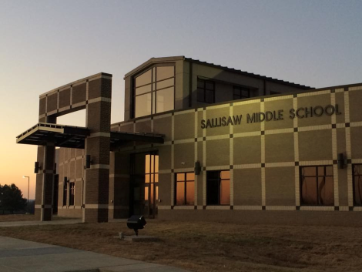

Sallisaw Public Schools
A) 2,024 Students
B) 11 Languages
C) 21% of students on an IEP
D) Per capita valuation of $26,693
E) 70% Free/Reduced

Slide 3
Sallisaw Public Schools
F) Teacher salary is $2,000 above state minimum
G) Local compensation is $10,275 less than Ft. Smith
* 15 years experience

Slide 4
Source: ACT

Slide 5
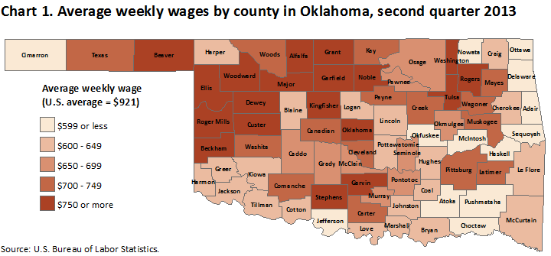

Slide 6
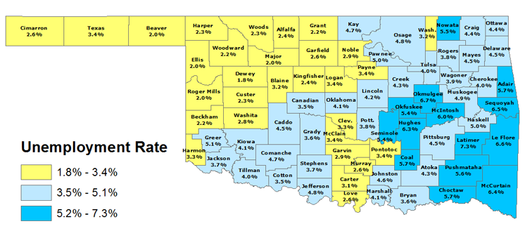

Slide 7
Economy Overview
Population (2015) ………....41,402
Jobs (2015)………………….... 14,308
Average Earnings (2015).. $29,093
Unemployed (4/2015)……. 989
Completions (2014) ………..119
GRP (2013) …………………….$666,228,720
Exports (2013)………………. $1,038,732,240
Imports (2013)………………. $1,606,809,600
        Source: EMI Economic Modeling

Slide 8
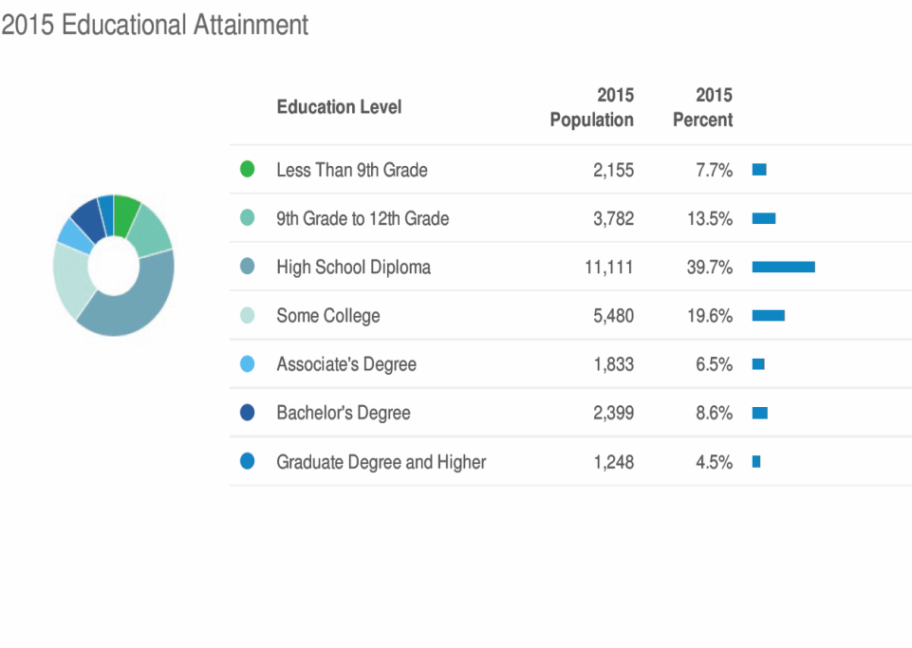

Slide 9
Households with at least one Bachelor’s Degree
State Avg. 23.2%
Sequoyah County Avg. 13.1 %

Slide 10
How can we adjust our trajectory?
Grow capacity and partnerships between post secondary institutions
Involve the business community in all phases of education
Stay ahead of regional workforce demands
Grow expectations for completion and workforce development

Slide 11
Scholars Program
Overview
Creates a new diploma offering that requires a total of 33 credits for graduation (traditional diplomas require 25 to 27 credits)
Current eligibility requirement
* ACT score of 19
C) Allows Students to enroll in 6 credit hours though concurrent enrollment and 6 additional hours provided by CASC-- 24 hours total during this program

Slide 12
Scholars Program
Overview
D) When not at CASC, students will be enrolled in Leadership electives at various locations within our PK-12 school district.

Slide 13
Goals
Increase rate of students attending college
Reach students who do not have means to support their postsecondary endeavor
C) Increase the rate of completion for 2 year and 4
year degrees
D) Increase participation in Teacher Education
Programs
E) Increase enrollment at CASC
F) Increase the capacity in which we serve students
at our PK-12 sites

Slide 14
Questions?

