Slide 1
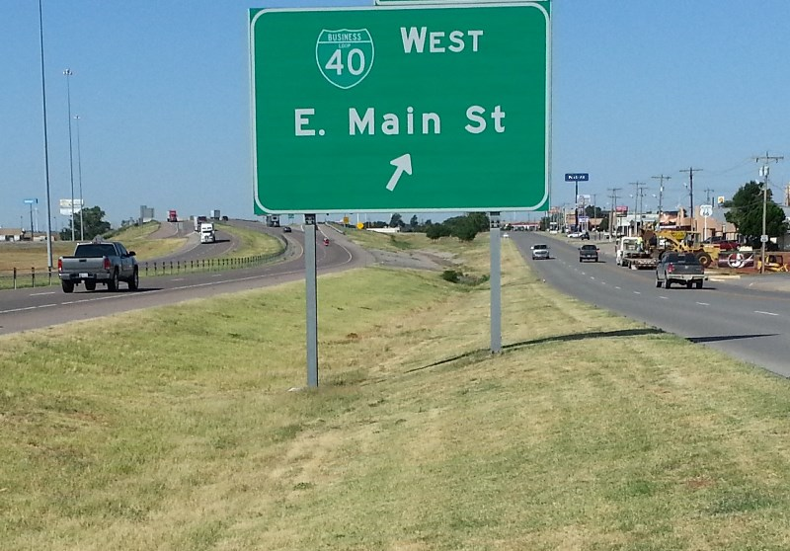
Western Oklahoma I-40 Corridor
Stronger Economies Together
Oklahoma State Regents for Higher Education
January 14, 2014

Slide 2
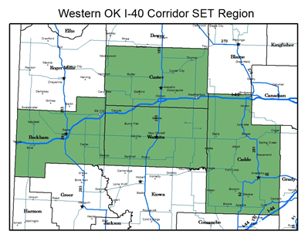

Slide 3
The SET Training Modules
The Basics
The SET Initiative: An Introduction
Profiling Your Region
Gearing Up
Building a Strong Regional Team
Developing Your Vision and Goals
Resources & Strategies
Planning for Success
Moving Into Action
Focusing on Regional Comparative Advantage
Exploring Strategies for Enhancing the Regional Economy
Measuring for Success
Discovering Assets & Barriers
Notes:
We encourage SET regional teams not to bypass any of the modules. There is a good possibility that a team will discover some useful information in each of the modules, even if a module happens to address a topic they feel they have already addressed in some other training venue.

Slide 4
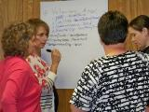
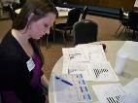
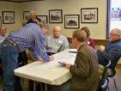
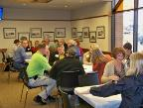
What SET Provides Regional Teams
35-40 hours of on-site training
Hands-on, step-by-step process for building or enhancing regional plans
Detailed demographic and socio-economic information
Data and analysis on current and emerging clusters
Guidance in implementing the plan
Access to individuals with special expertise
More in-depth cluster analysis
Monthly calls with State Partner and Training Team Members
Webinars on key topics of relevance to multiple regions
Training
Data & Analysis
Technical Assistance
Peer-to-Peer Networking
Notes:
The third phase is focused on RESOURCES AND STRATEGIES. The three modules in this section showcase the many tools and resources a team can employ as it builds and implements its regional goals and plan. These resources include important economic characteristics of the region, such as the attributes of its workforce. The region’s comparative economic advantages, especially the presence of economic clusters, is examined in the first of the modules in this section. The second module in this section gives attention to economic development strategies a team can use to strengthen and add value to the cluster being addressed by the team, while the third module introduces innovative ways to uncover regional assets and possible barriers that might impact the achievement of the team’s regional goals.
The final section focuses on MOVING INTO ACTION. The two modules associated with this last phase of SET offer a detailed roadmap on how to get important projects off the ground and how to gather the type of information needed to ensure these regional efforts stay on track.”
Additional Comments:
We encourage SET regional teams not to bypass any of the modules. There is a good possibility that a team will discover some useful information in each of the modules, even if a module happens to address a topic they feel they have already addressed in some other training venue.

Slide 5
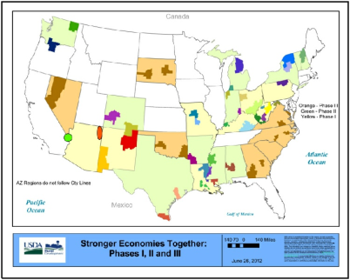
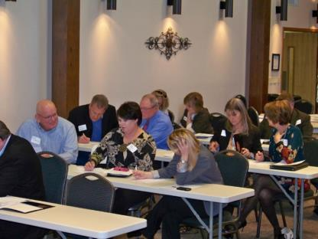
Current Features of SET
Its Purpose:
Help rural communities/counties work together as a regional team in developing and implementing an economic development blueprint that builds on the region’s current and emerging economic strengths.

Slide 6
The Western OK I-40 Region

Slide 7
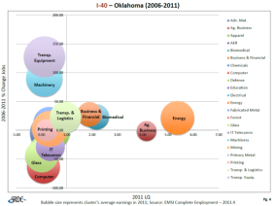
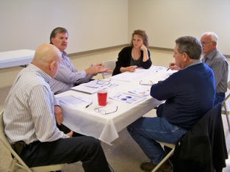
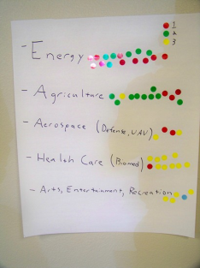
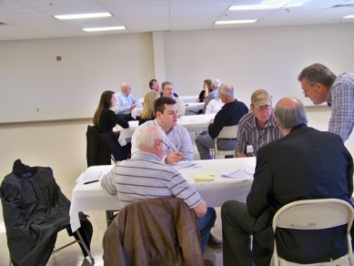
The Western OK I-40 Corridor Experience
Module 5: Determined Clusters of interest (using bubble charts)

Slide 8
Developing and Implementing a High Quality Plan
Evidence-Based
Practical
Team’s
Regional Plan
Broadly Supported
Aligned with Vision & Goals
Focused on Regional Economic Development
Notes:
Evidence-based: The plan builds on the region’s economic strengths – including its current and emerging economic clusters and other relevant assets.
Practical: The plan is logical and clear, has a well-developed timeline, indicates who is responsible for carrying out the various components of the plan, and indicates outcomes to be achieved over the short, medium, and long-term basis.
Broadly Supported: Having support of a wide range of people, governments, and community-based organizations is essential for the plan. Not only is it important to have a plan that is supported by economic development and local government leaders, but also one that has buy-in from people representing the region’s education, health, business, faith-based, and nonprofit sectors, as well as key demographic groups.
Focused on Regional Economic Development: The central focus of the plan must be on strategies that directly or indirectly advance regional economic development. That is, the economic development blueprint must be designed to benefit the whole region rather than a single community, county or sub-area of the region.
Aligned with the Vision and Goals: The plan must be in synch with the regional team’s vision statement and the specific goals they have developed.”

Slide 9
Goals
1 – Re-establish and expand aerospace industry.
2 – Create diversified agriculture and value-added products.
3 – Expand energy sector through diversification and recruit administration.
4 – Improve healthcare facilities, staffing and technology.
5 – Develop amenities that will support strong community lifestyles.

Slide 10
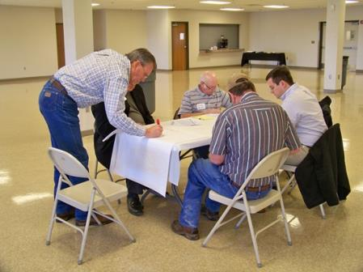
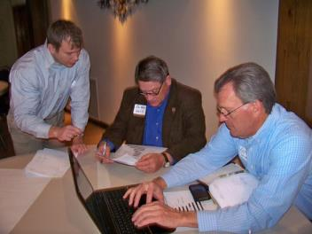

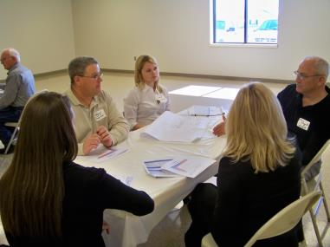

Slide 11
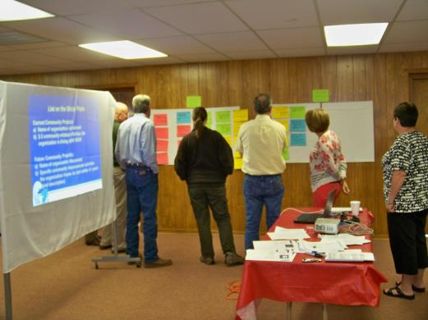
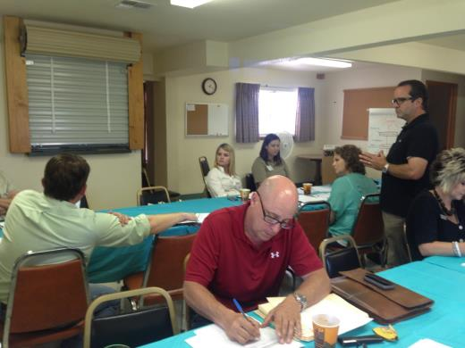
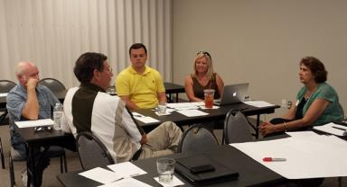
http://greatplainsrcd.org/set.html
http://srdc.msstate.edu/set/
Notes:
Summary
The Oklahoma Stronger Economies Together program assisted the four county region of Caddo, Custer, Beckham, and Washita counties in training and developing a high quality strategic plan. These counties are connected by Interstate Highway 40 that parallels historic route 66 through western Oklahoma. This newly formed team along the corridor has identified several potential economic assets to diversify and strengthen its economy in a sustainable manner. The strength of the region is historically agriculture and energy. The plan is nearing completion and regional team members are looking forward to accomplishing some worthwhile goals. The training process has brought together several individuals from all over the region who are now communicating and collaborating on potential projects to benefit the region.
Our priority goal is to re-establish and expand aerospace industry utilizing a very unique asset and supporting infrastructure. Another goal is to create diversified agriculture and value-added products to capture more of the dollars that are leaking out of the region. Our strong petroleum based energy sector is already becoming diversified with several renewable energy options and we intend to recruit more of the administration sector. Healthcare is also identified with improving facilities, increasing staffing and expanding technology. Amenities will be developed that will support strong community lifestyles and provide services to retain youth in the region.

